Slide 1

HR Analytics Dashboard by Group 2
KPI-Driven Attrition & Workforce Strategy
Tools: Excel | SQL | Power BI | Tableau

Slide 2

AGENDA
GROUP 2 MEMBERS
Srishti Gupta
Arunkumar
Rade Rachna
Shaikh Arshad Mohammed Aslam
Aswitha . S
ERANNAGARI SHARATH KUMAR

Slide 3

Core KPIs Used
Overall Attrition Rate
Attrition by Department
Attrition vs Monthly Income
Attrition vs Promotion Gap
Work-Life Balance Index
Average Working Years
Compensation Indicators

Slide 4

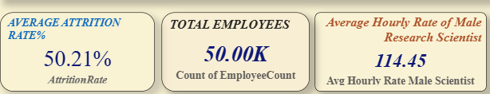
Key Insight
Attrition rate is ~50%, which is critically high
Indicates systemic HR issues, not isolated team problems
Inference:
Retention risk exists across the organization.

Slide 5

Insight
R&D shows the highest attrition (~51%)
Hardware is relatively more stable
Attrition across departments remains close to 50%
Inference:
Attrition is policy-driven, not department-specific.

Slide 6
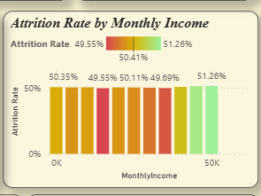
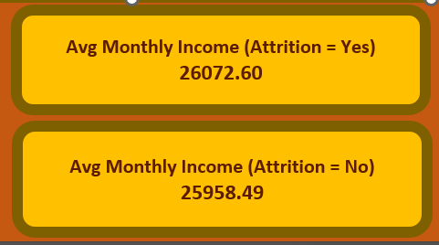
Key Observations
High attrition in lower salary bands → early dissatisfaction
Significant attrition even among higher earners
Average income difference between attrition “Yes” and “No” is minimal
Inference:
Salary alone does not ensure retention — growth and recognition matter more.

Slide 7
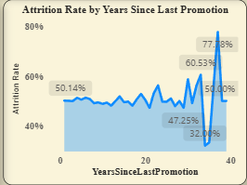
Insight
Attrition increases sharply after long promotion gaps
Employees tend to stay initially but exit after prolonged stagnation
Inference:
Employees don’t leave suddenly — they leave after waiting too long.

Slide 8
Key Observations
Developers & Managers show lower WLB scores
Support and healthcare roles show better balance
Inference:
Burnout-prone roles are predictable attrition hotspots.

Slide 9
Insight
Average tenure remains ~20 years across departments
Minimal variation across functions
Inference:
Employees are not leaving early — experienced employees are exiting, increasing replacement cost.

Slide 10

What the KPIs collectively tell us
Attrition is structural, not situational
Promotion stagnation drives disengagement
Compensation without differentiation reduces motivation
Burnout roles show higher attrition risk
HR risks are measurable and predictable

Slide 11
Insight Identified | Strategic Action
High attrition across levels | Organization-wide retention strategy
Promotion stagnation | Promotion review every 3–5 years
Burnout in technical roles | Role redesign & workload balance
Salary compression | Skill-based compensation bands
Early dissatisfaction | First-year engagement & feedback loops

Slide 12
HR ACTION ROADMAP
Short Term
Identify high-risk employees using KPIs
Conduct stay interviews
Address workload imbalance
Medium Term
Transparent promotion framework
Role-based pay benchmarking
Long Term
Predictive attrition models
Continuous HR KPI monitoring

Slide 13
Expected Outcomes
Reduced avoidable attrition
Higher employee engagement
Stronger talent retention
Data-driven HR decision-making

Slide 14

THANK YOU

